Slide 1
Accelerating the Artificial Bee Colony Algorithm by Hardware Parallel Implementations Presenter – Michael Onileowo

Slide 2
Introduction
Swarm intelligence-based algorithms have become useful techniques for solving optimization problems. Inspired on the intelligent foraging behaviour of honey bee swarms, the ABC has the advantage of easy implementation using fewer control parameters and parallel capabilities that can be explored so as to increase performance.
The ABC algorithm has been used for solving numerical optimization problem in which computational time is not a problem but it has shortcomings when dealing with applications such as online parameter estimation, mobile robotics controllers, adaptive control etc because they are required to perform optimization in real time.
The above suggests that using parallel architectures of the ABC algorithm will allow execution time to be decreased.
Previous parallel architectures of the ABC algorithm are GA (genetic algorithm), ACO (ant colony optimization) and PSO (particle swarm optimization) etc
Opposition based learning (OBL), introduced by Tizhoosh [1], is a technique that combat the “premature convergence problem” experience by population based algorithm. It can be used in two ways –
1. To improve the efficiency of algorithms by enhancing the searching process in the opposite direction of the current search
2. For introducing artificial diversity avoiding the “premature convergence” problem.
The above is the motivation for the proposal of FPGA parallel architecture for a novel ABC algorithm which makes use of the OBL approach.

Slide 3

Background.
The ABC algorithm, introduced by Karaboga [2], simulates intelligent foraging behaviour of honey bee swarms.
The colony of artificial bees are classified into three groups
1. Employed bees are associated with a certain food source they are currently exploiting or are employed at
2. Onlookers waiting in the dancing area of the nest, make decision of which food source must be followed based on information from employed bees
3. Scouts who surrounds the nest are continually looking (random search) for a food source to exploit.
The algorithm is
where i=1,…,S,S is the size of the population, pi is the probability of the i-th solution, fi is the fitness of the i-th solution and max(f) is the maximum fitness in the population of solutions.

Slide 4

The Opposition-based Learning (OBL) approach allows the population-based approach above to search for an optimal point in the opposite direction. The idea is that when a solution is being exploited in one direction, it is beneficial to consider the opposite direction too.
This technique was initially applied to genetic algorithm in which anti-chromosomes allow the search process to be accelerated and has been applied to neural computing in which the concepts of opposite weight and opposite network can be used to improve results [1].
Other places OBL has been applied are Differential Evolution (DE), Ant Colony Optimization (ACO) and Particle Swarm Optimization (PSO) [3] [4] [5].
The algorithm for OABC is
where k=1,…,S,j=1,…,N,N is the dimensionality of the problem, ϕij is an uniform random number generated in the range [–1, 1]. In this equation k and j are randomy generated and k needs to be different of i.

Slide 5
FPGA Implementation
The proposed HPOABC architecture used several floating-point libraries for arithmetic computations [6] – this is justified given the dynamic range required during optimization process where the algorithm operates between large and small real numbers.
Two modifications were made. The first is the use of a simplified random number generator (RNG) based on a linear feedback shift register (LFSR) which provides pseudo-random binary sequence and the second is the stochastic behaviour of the original ABC algorithm is based on several agents moving randomly on a search space.
As stated by equation for OABC the bees update process requires to use an RNG, two additions/subtractions (FP Add) and one multiplication (FPmul).

Slide 6
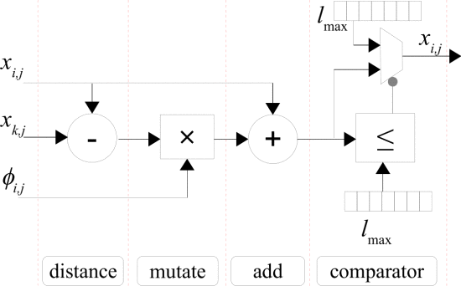
Fig. 1 shows the implementation of the update process for one single bee. The update process is performed in four sequencial states. States one and three share the same FP add unit. The last state checks if the new position xi,j left the search space. Since employers and onlooker bees update their positions at different moments; the same architecture can be shared for both employers and onlookers, saving hardware resources.
Fig. 1. Architecture for updating the bee position

Slide 7
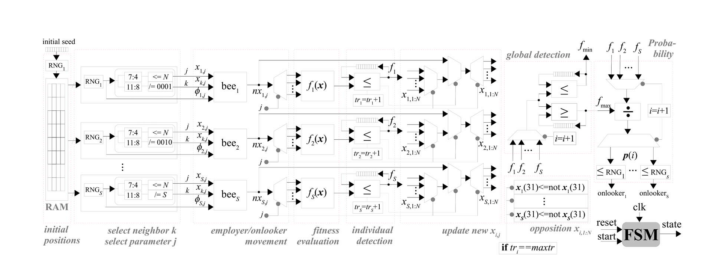
Fig. 2 depicts the general architecture of the proposed HPOABC algorithm. It is composed of several sequencial states that are controlled by a finite state machine (FSM). At the first state a RNG initializes the bees position and store it in a register. Afterwards, S parallel RNGs are computed and used for selecting the neighbor k and parameter j to be optimized. At the third state, these RNGs are used as inputs of S parallel bees (above explained).

Slide 8
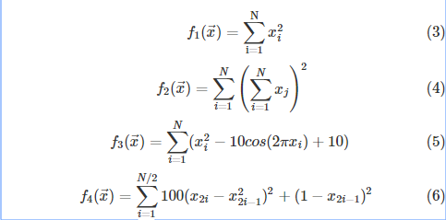
Results
The proposed HPOABC architecture was synthesized in the ISE 10.1 development tool for a Virtex5 FPGA device. In this work we report results for a specific case of 10 parallel food sources using 10 employers and 10 onlookers (S=10) optimizing a 6-dimensional problem (N=6). Four well-known benchmarks were used for validating the proposed architecture. A minimization objective is intended in order to find the global minimum point of the Sphere (3), Quadric (4), Rastrigin (5) and Rosenbrock (6) benchmarks. All the fitness functions have a global minimum value equal to zero (f(x)=0) at the positions x(i)=0 for the Sphere, Quadric and Rastrigin problems and x(i)=1 for the Rosenbrock problem, where i=1…N

Slide 9
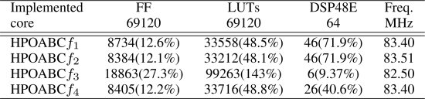
A. Synthesis Results
The cost in logic area is reported in terms of flip-flops (FF), Look-up tables (LUTs) and dedicated DSP blocks consumption. The performance is represented in Megahertz. As expected, the hardware resource utilization depends on the complexity of the optimization problems. It can be observed that the proposed HPOABC architecture is effectively implemented on the FPGA device for the f1,f2 and f4 benchmarks, having more that 50% of the available resources for future implementations. Table below is the Synthesis Results (chip xc5vlx110t), 10 food sources, 32 bits

Slide 10
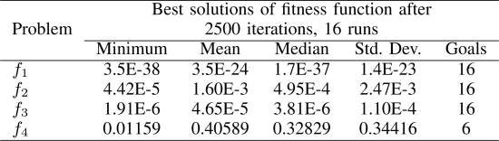
B. Convergence Results
The proposed HPOABC architecture was mapped and downloaded in the FPGA board. The ModelSim simulator tool was used for evaluating the convergence results. The convergence results was for a search domain of [-7.0,7.0], 100 maximum trial iterations (to apply the OBL approach) and a fitness threshold of 0.1. It can be observed that the proposed HPOABC hardware architecture achieves satisfactory results. However, in the case of the f4 problem, although the algorithm achieves the minimum valley, it does not refine the final solution providing poor convergence results. This drawback can be overcome by using a weight parameter with linear decrement which allows the size of bee flight to be adjusted at the last iterations.

Slide 11
Conclusions
This work has presented an FPGA implementation of the ABC algorithm with opposition-based learning approach (HPOABC). The proposed hardware architecture takes advantage of using a simple operator (not operator) for improving the quality of the solution and preserving swarm diversity, avoiding premature convergence. The HPOABC architecture uses the suitable floating-point arithmetic allowing high resolution and large dynamic range computations.
Synthesis results demonstrates that the proposed architecture is effectively mapped on FPGAs and achieves an operational frequency of 83MHz. In addition, convergence results point outs that the HPOABC achieves satisfactory results for optimizing unimodal and multimodal benchmark problems.

Slide 12
References
1. H. Tizhoosh, "Opposition-based learning a new scheme for machine intelligence," in Proc. Int. Conference on Computational Intelligence for Modelling, Control and Automation, 2005, pp. 695-701, Vienna, Austria.
2. D. Karaboga. An idea based on honey bee swarm for numerical optimization. Technical report, Erciyes University, Engineering Faculty, Computer Engineering Department, 2005.
3. H. R. S. Al-Qunaieer, F.S. Tizhoosh, "Opposition based computing a survey," in Proc. Int. Joint Conference on Neural Networks, 2010, pp. 1098-7576, Barcelona, Spain.
4. A. Malisia and T. H.R., "Applying opposition-based ideas to the ant colony system," in Proc. IEEE Swarm Intelligence Symposium, 2007, pp. 182-189, Honolulu, HI.
5. H. Jabeen, Z. Jalil, and A. Baig, "Opposition based initialization in particle swarm optimization (O-PSO)," in Proc. ACM Conference on Genetic and Evolutionary Computation, 2009, pp. 2047-2052, Montreal, Canada.
6. D. Muñoz, D. Sánchez, C. Llanos, and M. Ayala-Rincón, "Tradeoff of FPGA design of a floating-point library for arithmetic operators,"Journal of Integrated Circuits and Systems, vol. 5, no. 1, pp. 42-52, 2010.

